Slide 1
COMPONENTS
We are doing REACT now!

Slide 2
Learning objectives
TNTs will be able to describe the purpose of a React component
TNTs will understand how a component's key methods function
TNTs will practice building components

Slide 3
PART 1 REACT OVERVIEW
5 minutes

Slide 4

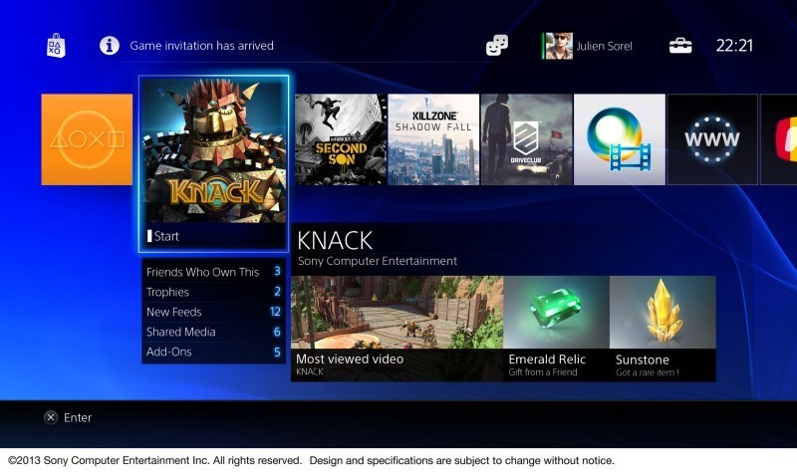
How does React work?
PS4
Nintendo 64
https://leanpub.com/reactjsforthevisuallearner
Notes:
These digital games are already downloaded and available to play. If you want to switch games, you don’t need to load in a new cartridge like the N64. Instead, you can turn off the current game and load a game that is already available on the console.

Slide 5
Overview: How does React work?
Traditionally: Multiple pages and multiple views => React: Single-page application with one page and multiple views
Traditionally: Multiple pages being available to load separately and a new page being loaded each time a new view is needed => React: a single page containing all possible views is loaded up-front and the active view can be dynamically toggled
With React, we can create single page applications by creating views for each part in our application (home page, login page, etc.) and dynamically toggle on and off the views depending on the state
One of the main features of React is that it is component-based. We can create reusable, predefined components that can be put together to create a view. The view does not exist without the components. A button is a component
Components can be reused across views. For example, a button component can be used on a home page and a login page.
Notes:
Because an application only has to load a single page at the beginning, navigating through different views in a React web application is really fast and requires no page loading.
In a single page application, a single page would be loaded and all the possible views in the navigation bar would be available. Although all of the views are available, there is only one active view for the home page. If a user clicks on the sign in link, the home page view would be toggled off as the active view and the sign in view would be toggled on. There is no need for a separate page to be loaded.
Views refer to the content that would traditionally appear on a separate page on multi-page applications.

Slide 6
PART 2 COMPONENTS
5 minutes

Slide 7
What are components?
React components let you break up the user interface into separate pieces that can then be reused and handled independently
A React component takes an optional input and returns a React element which is rendered on the screen
A React component can be either “stateful” or "stateless“
“Stateful” components are of the class type, while “stateless” components are of the function type
React components may have props (properties) and state

Slide 8
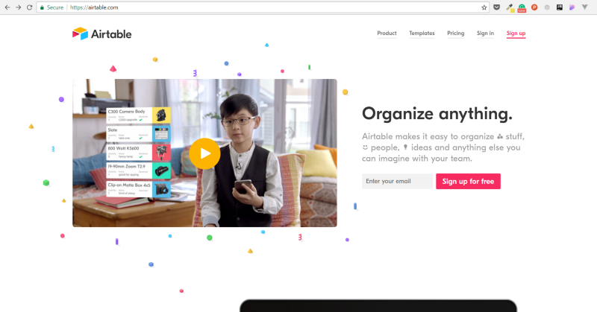
https://try.airtable.com
Notes:
Opt-in

Slide 9
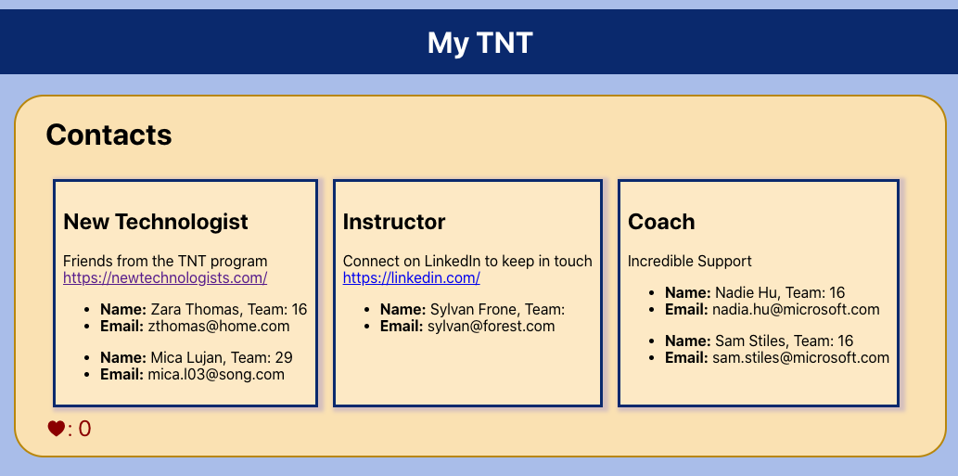
My TNT Exercise (covered today)
https://github.com/tnt-summer-academy/Exercises/tree/main/Week_2/ENG2.1-myTNT

Slide 10

What is a React element?
React elements are the building blocks of React applications
React elements describe what you want to see on the screen
React elements are immutable
React elements are returned by components
JSX
Notes:
https://reactjs.org/docs/glossary.htm

Slide 11
PART 3 CLASSES AND FUNCTIONS
10 minutes

Slide 12
PROPS, STATE, CHILDREN

Slide 13
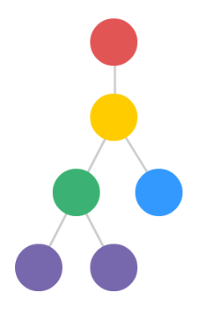
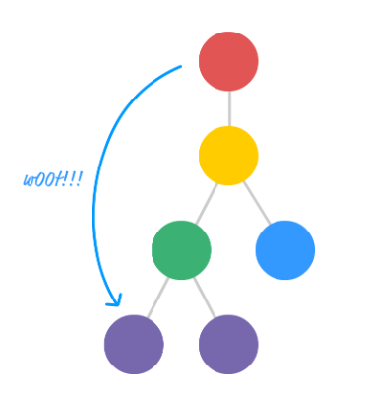
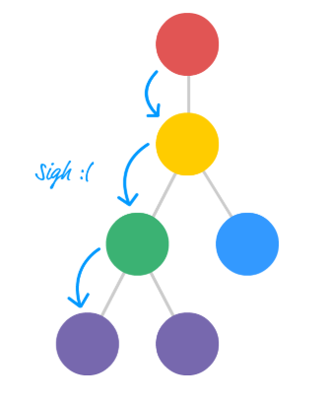
Props
<App name = ”John" city=”NYC">
https://www.kirupa.com
Optional
Read-only / immutable

Slide 14
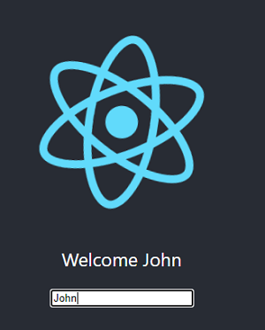
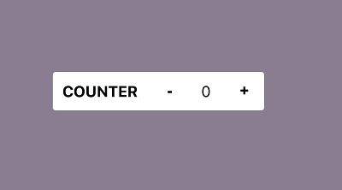
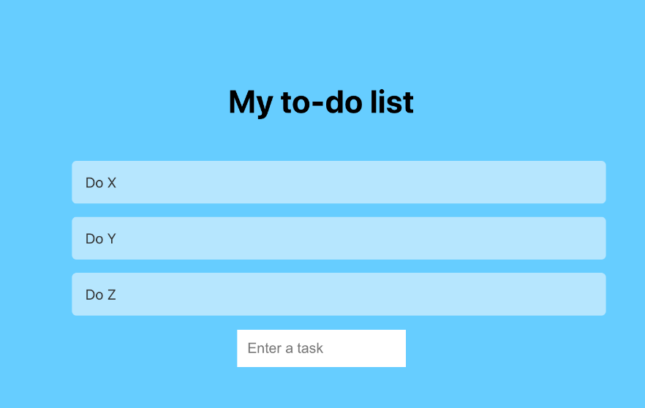
State holds information about a component (class)
Optional
Changes over time
The state is specific to a component. It is an object (written with an object literal) that holds information that can change over the lifetime of a component
Examples
The name is the current state
The value of the counter is the current state
The todo list is the current state

Slide 15
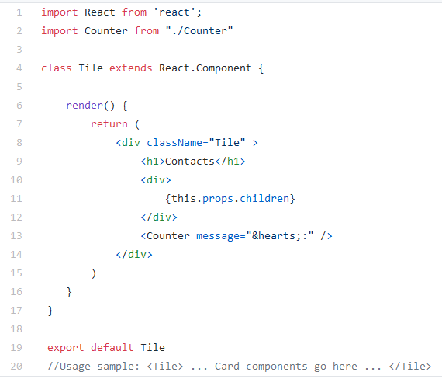
What’s children?
<Tile>
<Card> … </Card>
</Tile>
// Card is a children of Tile
You use (this.)props.children on components that represent ‘generic boxes’ and that ‘don’t know their children ahead of time’
(this.)props.children is used to display whatever you include between the opening and closing tags when invoking a component
Notes:
https://github.com/microsoft/TypeScript/issues/6471

Slide 16
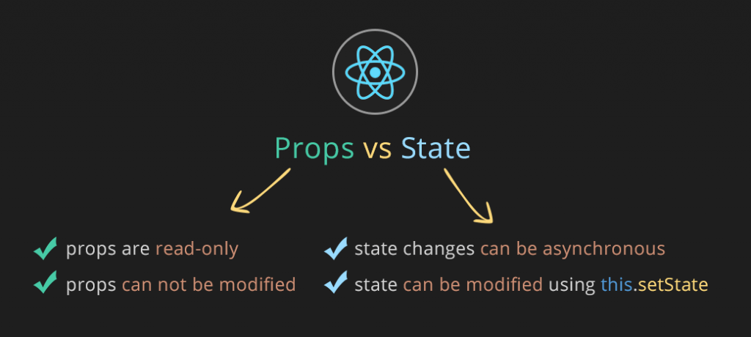
https://i.stack.imgur.com/wqvF2.png

Slide 17
CLASSES

Slide 18
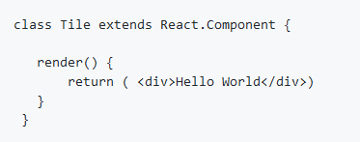
Classes
Render (required): This method returns the JSX element to be displayed by the class. It runs whenever the component's view updates.
Properties (optional): They are arguments passed into the component from its parent components. They cannot be changed by the component.
State (optional): They only exist within the components. Changing them causes the component to update.
Children (optional): Components nested inside the parent's JSX tags
Besides render(), class can include a constructor, lifecycle method calls and other additional methods.
Notes:
https://reactjs.org/docs/glossary.htm

Slide 19
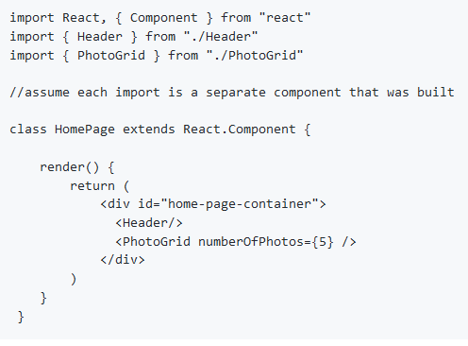
How are different components rendered?

Slide 20
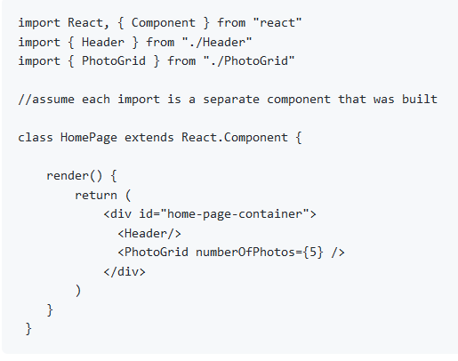
Rendering several components

Slide 21
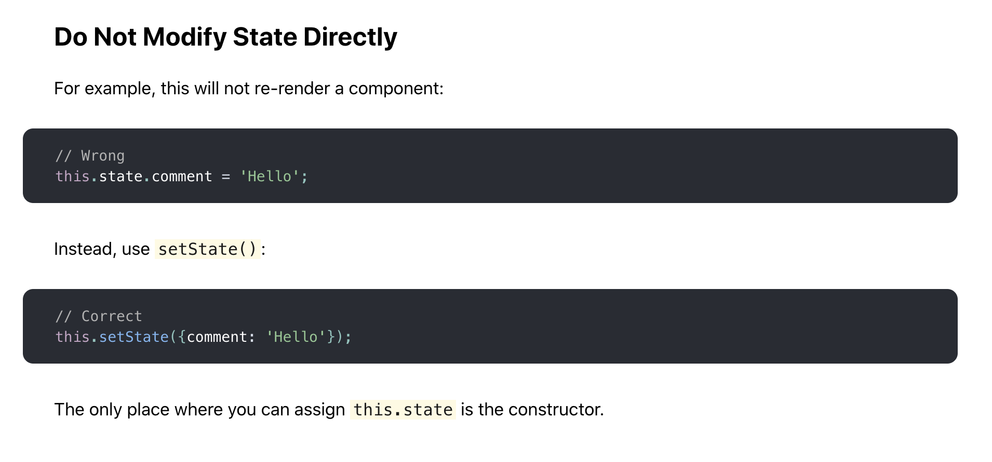
Using state correctly – Use setState
Read infos here: https://reactjs.org/docs/state-and-lifecycle.html#state-updates-may-be-asynchronous

Slide 22
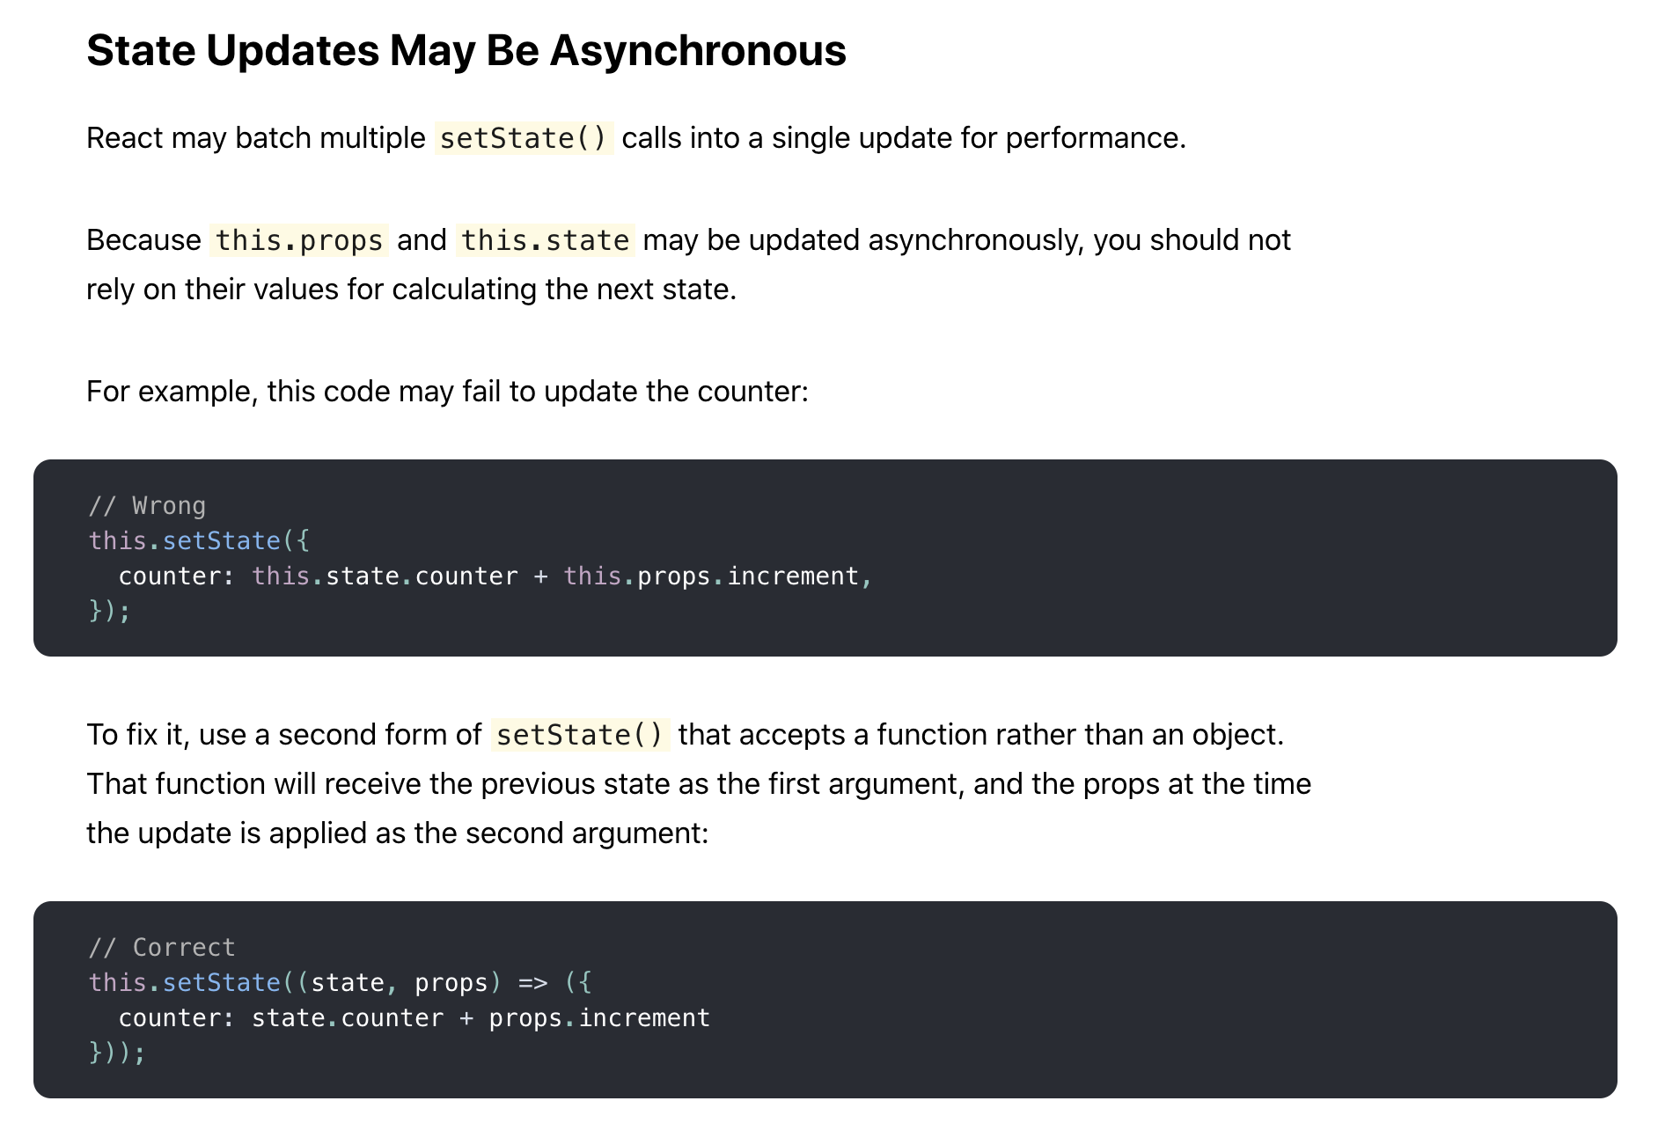
Using state correctly – Do not use this.props and this.state inside setState
Asynchronous changes and access

Slide 23
FUNCTIONS

Slide 24
Functions
Originally simple, stateless components; expected to return the JSX element to be displayed.
Properties (optional): These arguments are passed in from the component's parent similarly to passing parameters to a function. They cannot be changed in the component.
UseState: A hook function that returns a state variable, giving function components a way to manipulate a state the way class components do
Notes:
https://reactjs.org/docs/glossary.htm

Slide 25
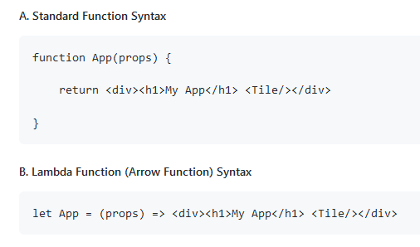

Slide 26
PART 4 REACT COMPONENT LIFECYCLE
5 minutes

Slide 27
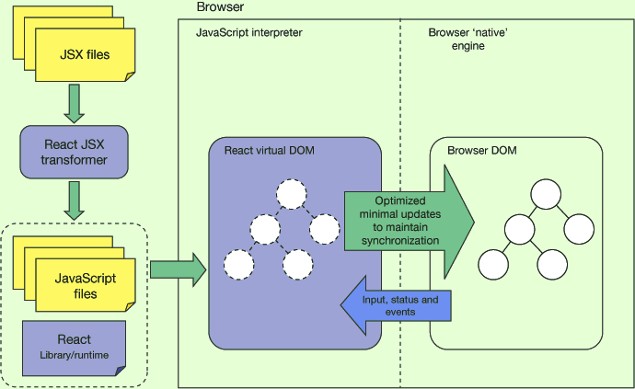
How does React work?
https://jsforall.com/reactjs/how-to-create-react-app-2019-how-virtual-dom-component-work
Notes:
In React, for every DOM object, there is a corresponding “virtual DOM object”. A virtual DOM object is a representation of a DOM object, like a lightweight copy. The output of the render method is a React element which is a simple, plain JavaScript object that maps and represents the DOM element in memory.
Updating the DOM is slow. but updating the virtual DOM is much faster. Updating DOM is usually the bottleneck when it comes to web performance. React is trying to solve this problem by using something called virtual DOM.

Slide 28
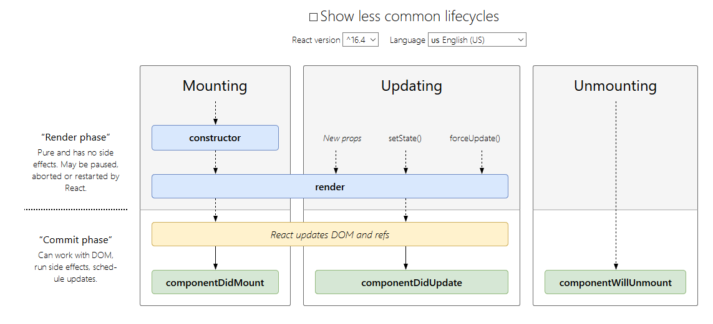
React Component Lifecycle Diagram
https://projects.wojtekmaj.pl/react-lifecycle-methods-diagram/
https://programmingwithmosh.com/javascript/react-lifecycle-methods
Notes:
https://programmingwithmosh.com/javascript/react-lifecycle-methods/
Refs provide a way to access DOM nodes or React elements created in the render method
Use setState() to schedule updates to the component local state. When the state changes, the component re-renders
New props re-renders the component

Slide 29
React Component Lifecycle functions
Mounting is the process of rendering a component to the DOM for the first time
Unmounting is the process of removing a component from the DOM
Other lifecycle functions
The componentDidMount() method runs after the component output has been rendered to the DOM. This is a good place to set up things
The componentWillUnmount() method runs when we do not need a component anymore. This is a good place to clear things up

Slide 30
PART 5 DISCUSSIONS
30 minutes

Slide 31
Discussion 1 -10 min
As a group
Choose a web site and share examples of potential stateful, stateless and reusable components you observe
Report back

Slide 32
Discussion 2 - 10 min
As a group
Imagine your daily schedule as a set of components, e.g., Wake up, Exercise, Breakfast, ....
What might be examples of: stateless and stateful components?
Component properties vs. state?
Reusable components?
Components made up of other components (composition)?
Report back

Slide 33
PART 6 MY TNT EXAMPLE
10 minutes
https://github.com/tnt-summer-academy/Exercises/tree/main/Week_2/ENG2.1-myTNT
In VSCode do npm install and then npm start

Slide 34
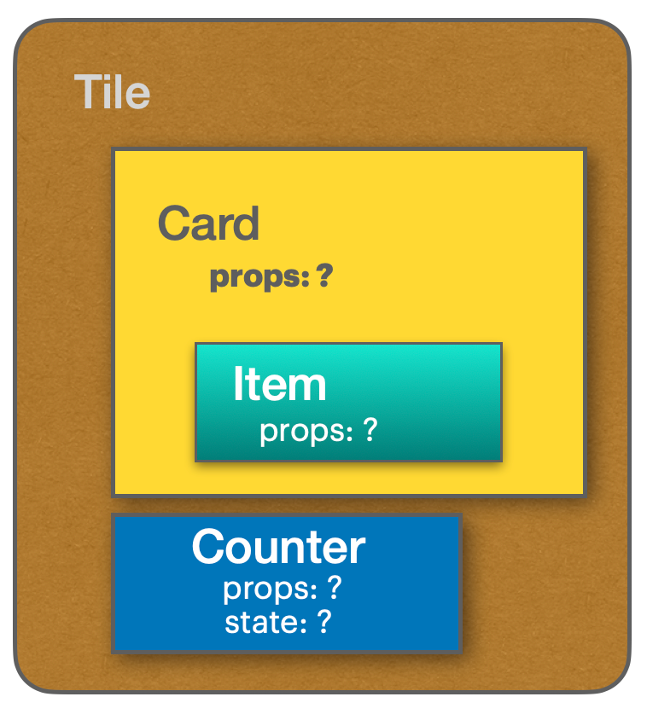
My TNT Exercise
Let’s explore the code. Let’s start with card!
https://github.com/tnt-summer-academy/Exercises/tree/main/Week_2/ENG2.1-myTNT
npm install react react-dom --save

Slide 35
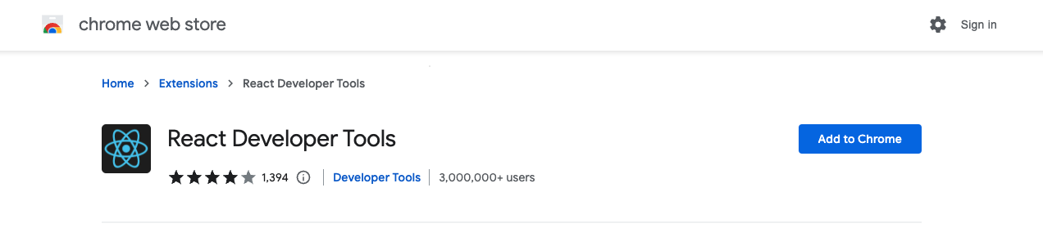

Slide 36
PART 7 ANNEX

Slide 37
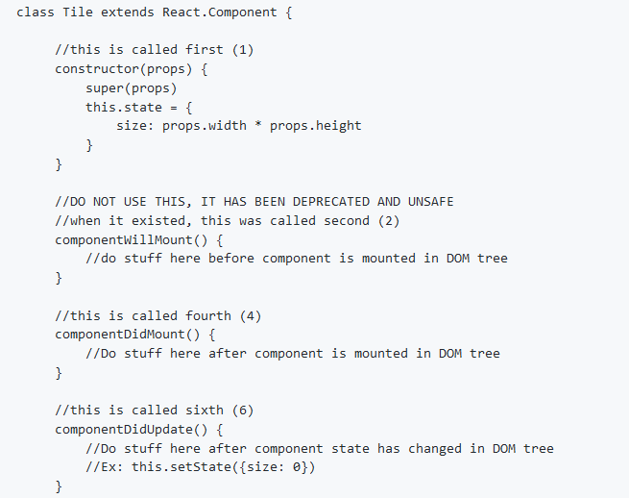
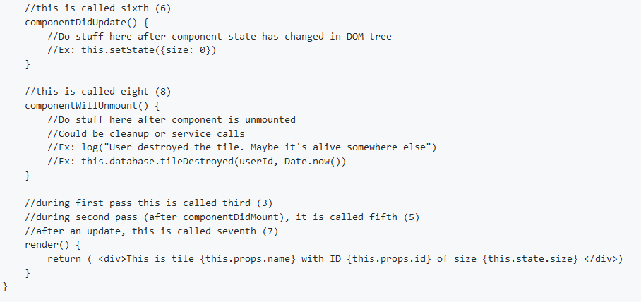
Constructor
componentWillMount
render
componentDidMount
render
componentDidUpdate
render
componentWillUnmount
https://github.com/tnt-summer-academy/Exercises/tree/main/Week_2/ENG2.1-myTNT

